Slide 1


Pet Management System
A web-based veterinary clinic manager with AI symptom assistance
Presenters: Melis Gedik - Doğa Ömrüuzun
Course / Instructor: Yüksel Arslan
Date: 24.12.2025

Slide 2
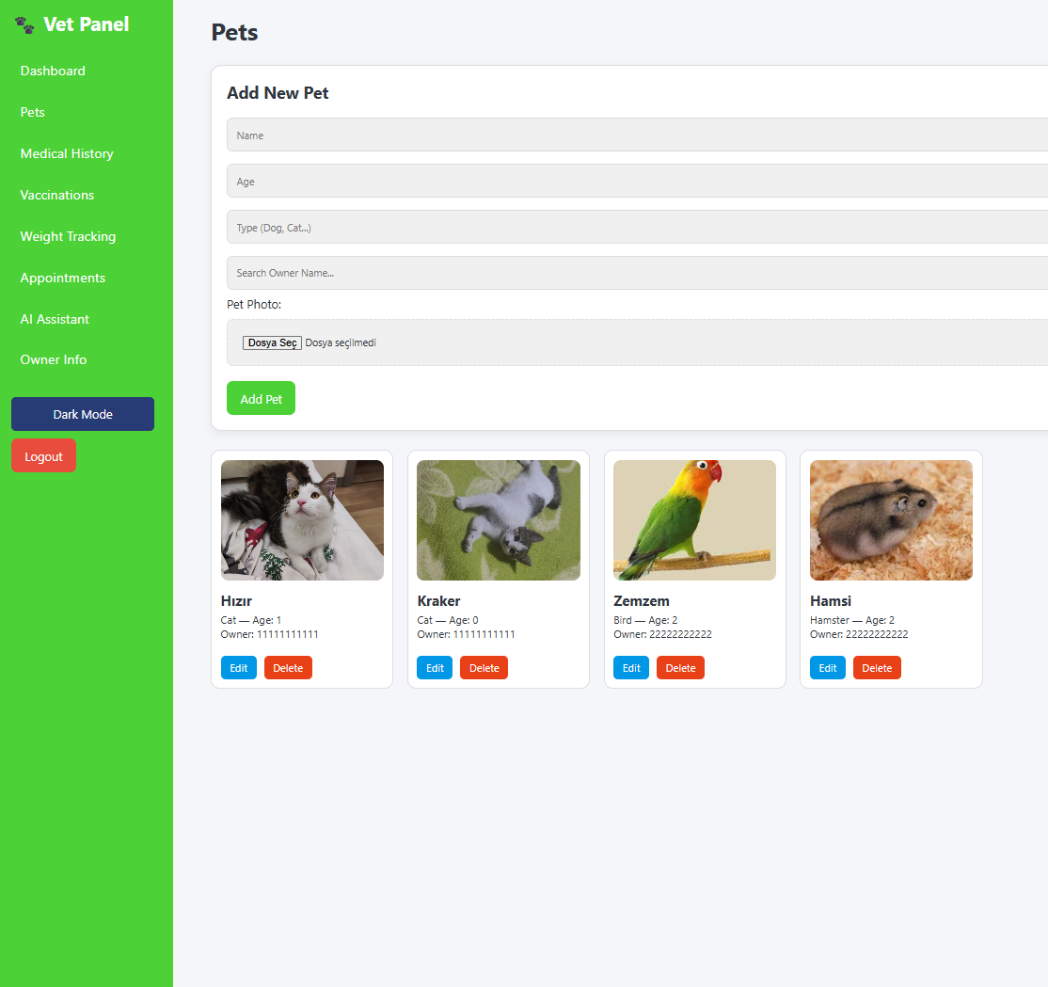
Project Purpose
Centralized Records: Consolidate medical history, vaccinations, weights, and appointments into a single interface.
Efficiency: Reduce manual tracking and provide quick clinical overviews at a glance.
AI Guidance: Provide AI-assisted symptom guidance for educational purposes (not diagnostic).

Slide 3
Original Project Requirements
Frontend: Built with semantic HTML, modern CSS, and vanilla JavaScript.
Backend: Developed using the Flask framework and Python.
AI Integration: An AI model running on the backend for symptom assistance.
Version Control: Project tracked rigorously in Git.
Hosting: Source code hosted on GitHub with URL shared at start.

Slide 4
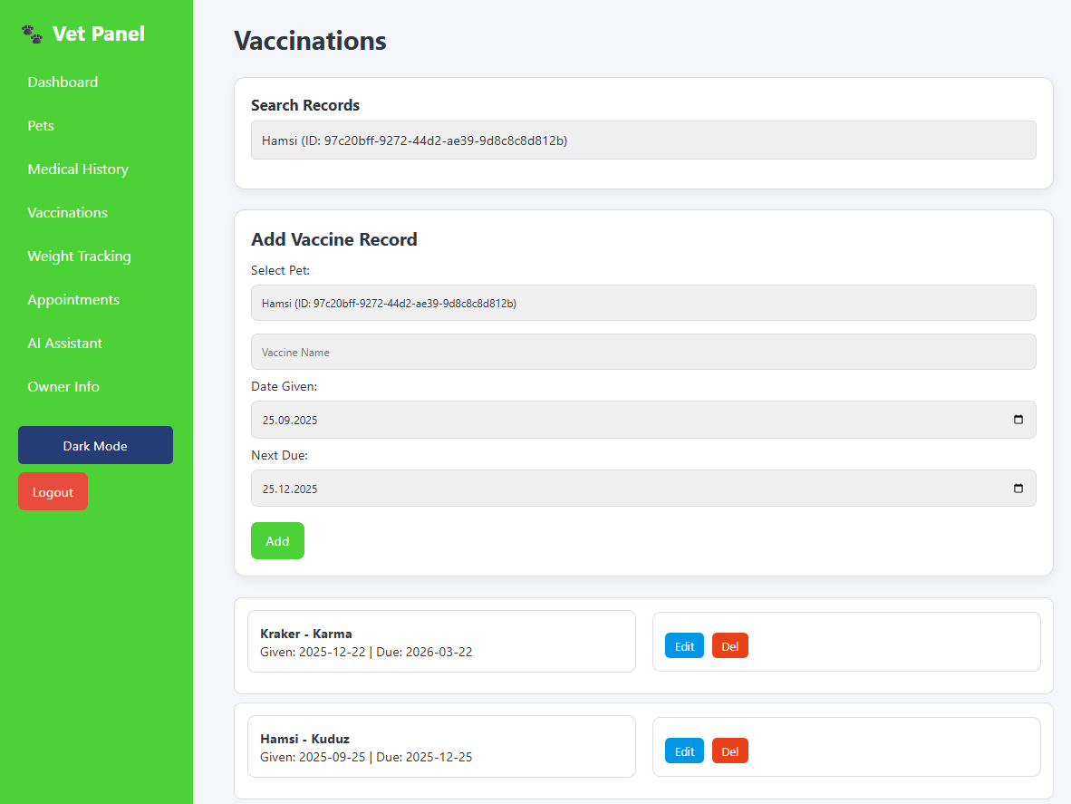
System Overview
Architecture: Single-page web app (SPA) feel with persistent sidebar navigation.
Key Sections: Dashboard, Pets, Medical History, Vaccinations, Weight, Appointments, Owner Info, AI Assistant.
UX Focus: Optimized for fast data entry, quick search capability, and a clean card-based layout.

Slide 5
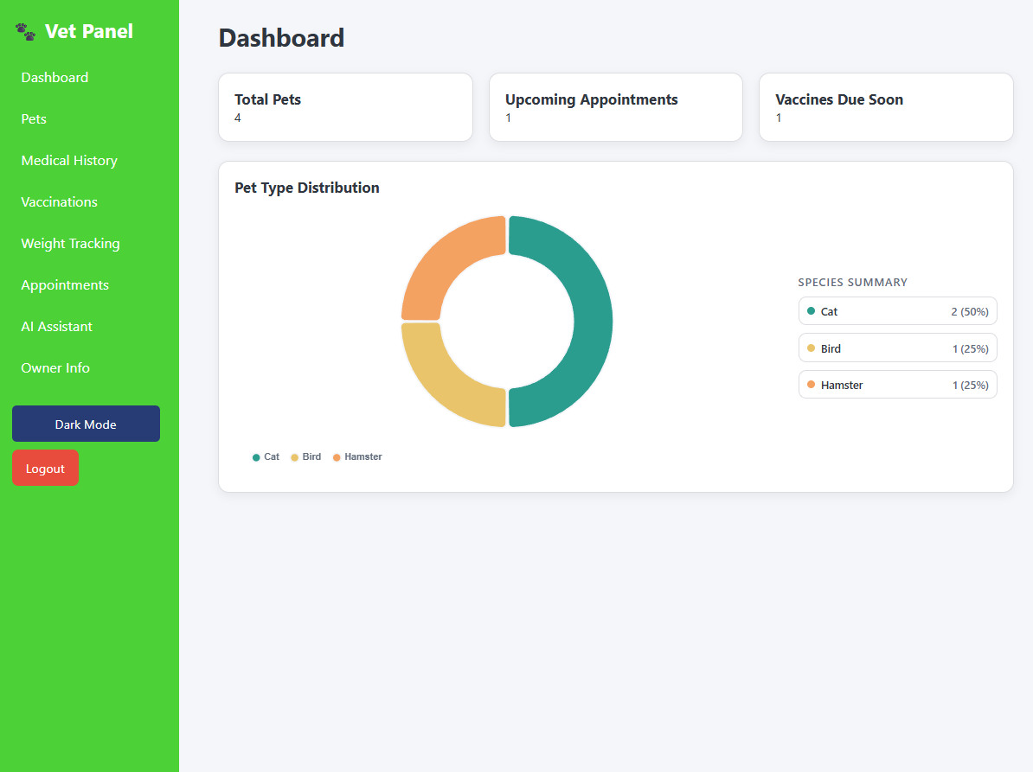

Dashboard & Analytics
Summary Cards: Instantly view total pets, upcoming appointments, and vaccines due.
Data Visualization: Pet Type Distribution chart visualizes species breakdown.
Prioritization: Helps veterinary staff prioritize daily workload efficiently.

Slide 6
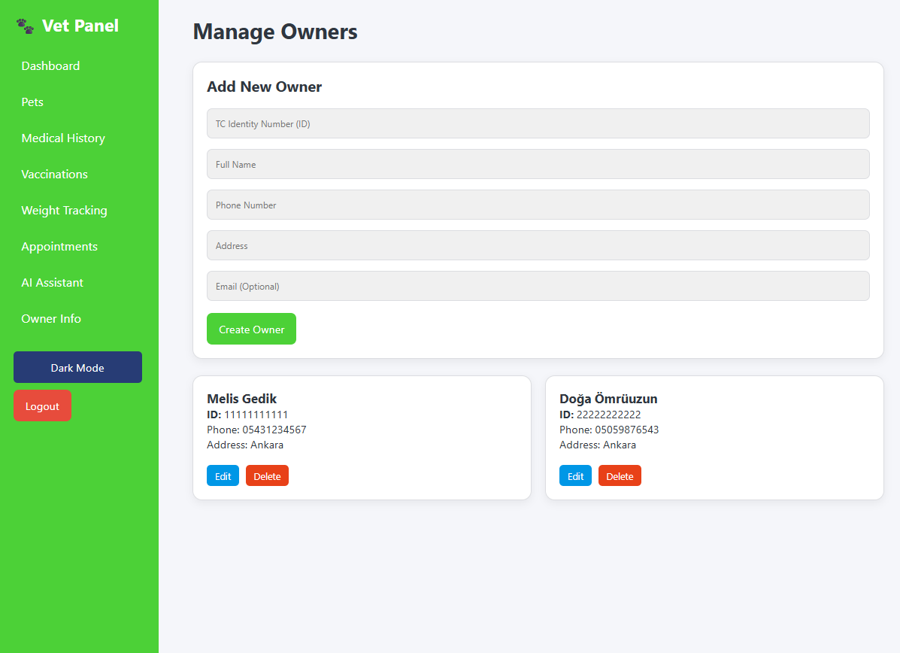
Pet & Owner Management
Pet Management: Add, edit, or delete pets including name, age, type, owner, and photo.
Owner Registry: Maintains ID, name, phone, address, and email for all clients.
Quick Association: Rapid owner search functionality to link pets during intake.

Slide 7
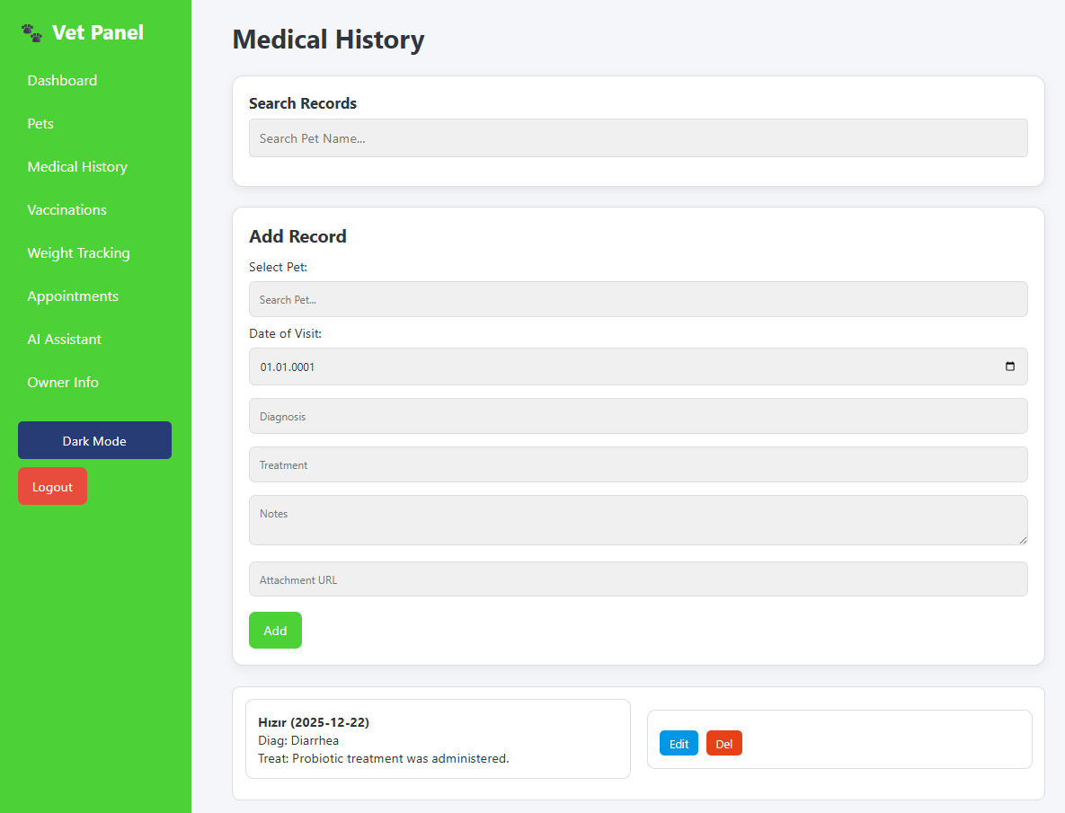
Medical Records
Visit Details: Comprehensive logging of visit dates, diagnoses, treatments, and clinical notes.
Attachments: Support for attaching files or imaging results to records.
History: Fully searchable medical history per pet with edit/delete capabilities.

Slide 8
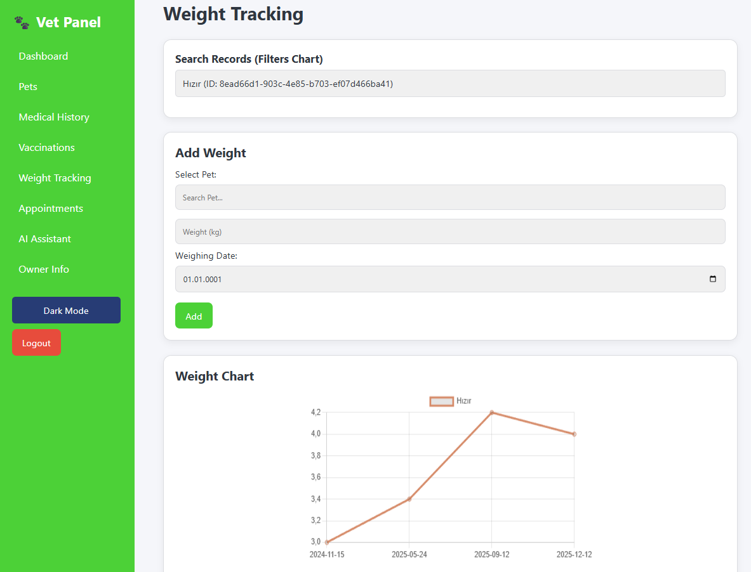
Vaccines, Weight, & Appointments
Vaccines: Track administration dates and next due dates with automated dashboard reminders.
Weight Tracking: Visual line charts track pet weight trends over time.
Scheduling: Manage appointments with date, time, reason, and assigned vet.

Slide 9
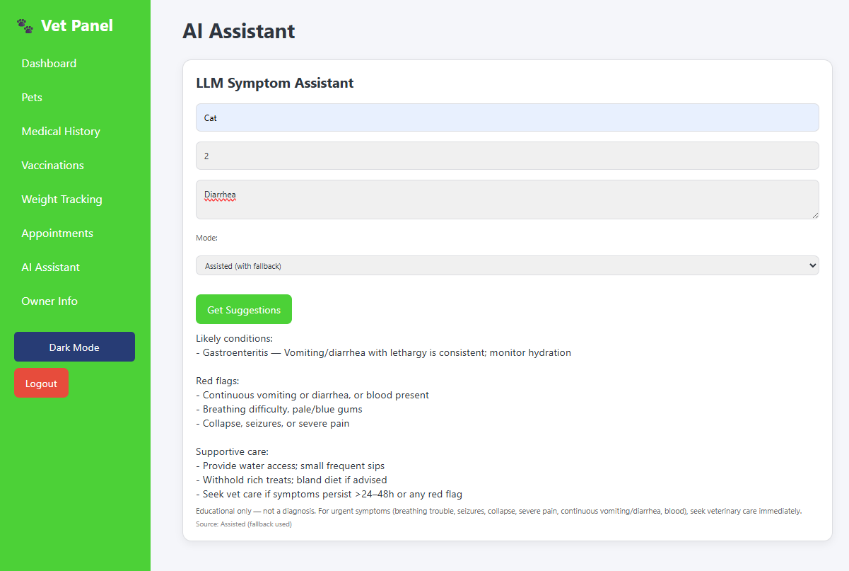
AI Symptom Assistant
Interaction: Users input species, age, and observed symptoms.
Processing: Backend LLM analyzes inputs to suggest likely conditions and care.
Safety: Identifies red flags and includes strict educational disclaimers.

Slide 10
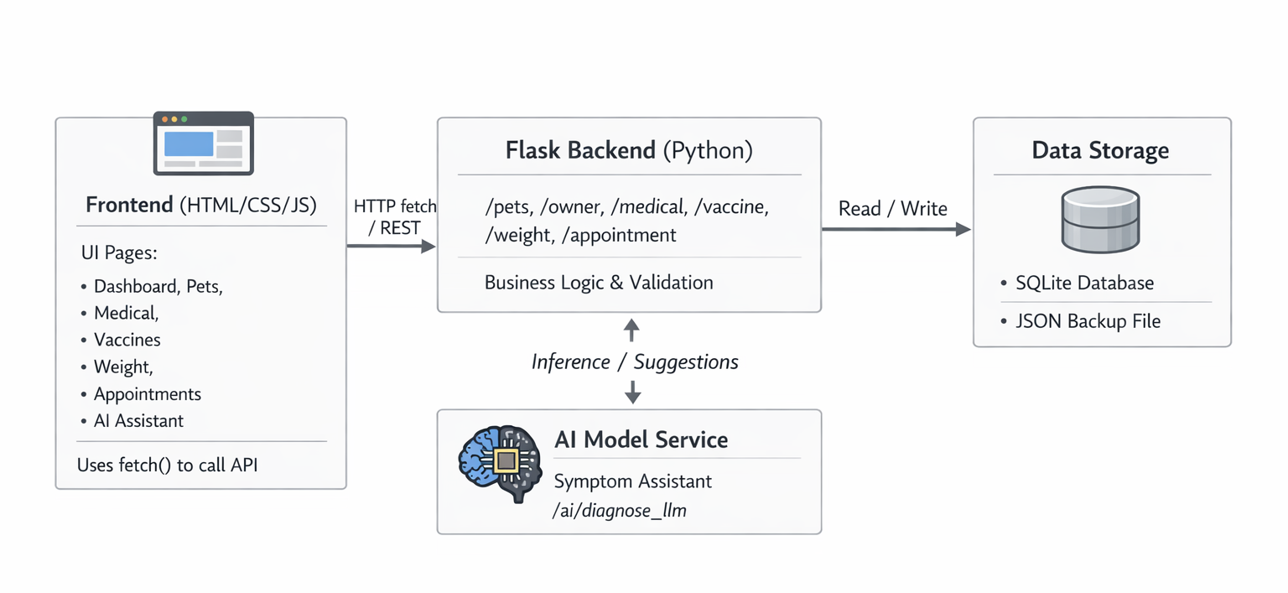
Backend Architecture
REST API: Flask-based endpoints for pets, owners, medical, vaccines, and appointments.
Persistence: Server-side data storage using SQLite with JSON backup mechanisms.
Communication: Frontend interacts asynchronously via standard JS `fetch` calls.

Slide 11
Tech Stack & Libraries
Frontend Core: HTML5, CSS3, JavaScript (ES6+).
Visualization: Chart.js used for dashboard metrics and weight tracking.
Backend Logic: Python 3.x with Flask microframework.
AI Models: Integrated Python model files for symptom analysis.
DevOps: Version control via Git and repository hosting on GitHub.

Slide 12
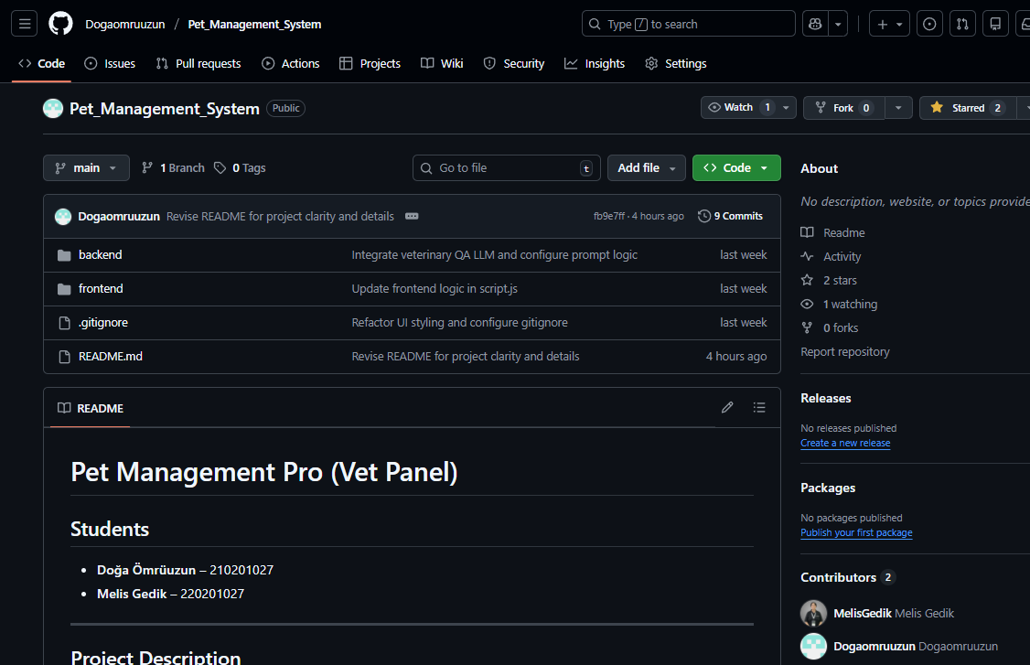
GitHub, Demo, & Next Steps
Repository: https://github.com/Dogaomruuzun/Pet_Management_System
How to Run: Start Flask server, then open local frontend URL.
Future Roadmap: Role-based access control, advanced analytics, mobile-first UI overhaul, and push notifications.

